Slide 1
Vector FPU
Ruei-Yuan (2019/6/12)

Slide 2
Vector FPU
Support 16-bit (half-precision), 32-bit (single-precision) operations
Support vector/scalar floating-point instructions
Fix latency for the vector/scalar floating-point instructions

Slide 3
Vector FPU
II
V1
V2

Slide 4
Vector FPU

Slide 5
Vector FPU per Lane (64-bit)
32’b0 or {16’b0, [63:48]}
32/16-bit FPU pipeline
32’b0 or {16’b0, [63:48]}
32’b0 or {16’b0, [47:32]}
32/16-bit FPU pipeline
32’b0 or {16’b0, [47:32]}
[63:32] or {16’b0, [31:16]}
32/16-bit FPU pipeline
[63:32] or {16’b0, [31:16]}
[31:0] or {16’b0, [15:0]}
32/16-bit FPU pipeline
[31:0] or {16’b0, [15:0]}

Slide 6
Vector FPU Pipeline
32
32/16-bit FMAC Pipeline
32/16-bit FPU MISC/CVT Pipeline
32/16-bit FPU DIV/SQRT Pipeline

Slide 7
Vector FPU Interface
input [`VRF_MASK_RANGE] vfxxx_clr_bits;
input [1:0] vfxxx_csr_ediv;
input [`EX_CTRL_RANGE] vfxxx_ex_ctrl;
input [`MOP_CNT_RANGE] vfxxx_mop_cnt;
input [`VRF_MASK_RANGE] vfxxx_msk_bits;
input [2:0] vfxxx_rmode;
input [`DATA_RANGE] vfxxx_rs1_data;
input vfxxx_rs1_valid;
input vfxxx_valid;
input [`CSR_LMUL_RANGE] vfxxx_vtype_lmul;
input [`SEW_RANGE] vfxxx_vtype_sew;
Input vfxxx_wide; // indicate the widening operation
Input vfxxx_narrow; // indicate the narrowing operation
output [`VRF_MASK_RANGE] vfxxx_mask;
output [`VRF_DATA_RANGE] vfxxx_data;
output [4:0] vfxxx_vfcsr_flag_set;
Note: xxx includes: mac, div, mis

Slide 8
Vector FPU Pipeline
FPU FMAC pipeline: ADD/SUB/MUL/MADD/MSUB/REDSUM/DOT instructions
FPU DIV pipeline: DIV/SQRT instructions
FPU MISC/CVT pipeline: CMP/MERGE/SIGN/MIN/MAX/CLASS/CVT/REDMAX/REDMIN/MV instructions

Slide 9
FMAC Pipeline (subnormal input)
V2
VF1
sub
VF2
VF3
op1
HA
sum
Hidden1
Gen
MUL
3:2
CSA
Sum
op2
HA
carry
op1
unpacked
op2
HA
carry
Carry
op3
Stick
Calc.
St1
St1
INV
71-bits Alignment Shift
CLZ pos
op3
Hidden1
Gen
LZA
CLZ neg
exp1
SHIFT
Amount
Calc.
Sign-detection
exp2
exp3

Slide 10
FMAC Pipeline (unpacked logic)
Unpacked logic includes:
16-bit unpacked
32-bit unpacked

Slide 11
FMAC Pipeline (subnormal output)
VF2
VF3
VF4
5-bit adder
St1
Sum
Normalization Shifter
<<
4-bit low part adder
5-bit adder
Carry
LZA
St1
sign
rounding mode
Subnorm?
EXP
LSB-adder
Carry and stick Calc.
Round Decision
LSB-adder
LSB-adder
inc
ovf
LSB Correction & special value detection
Dual-adder
Result
Select
decision
EXP result
Result

Slide 12
FMAC Pipeline (subnormal output detection)
Before normalization shifter:
Case1 (EXP>-126): 0.0001xxx*2^100
LZA result (4) for normalization shifter
After normalization 1.xxx*2^96
Case2 (EXP>-126): result 0.0001xxx*2^-125
LZA result (4) for normalization shifter
After normalization 1.xxx*2^-129
Case3 (EXP<-126): result 0.0001xxx*2^-130
LZA result (4) for normalization shifter
After normalization 1.xxx*2^-134

Slide 13
FMAC Pipeline (proposed subnormal output detection)
Example:
Case1: 0.0001xxx*2^100
EXP(100) and (EXP(100) – LZA(4) =96) > -126
Select 4 (LZA result) for normalization shifter
After normalization 1.xxx*2^96
Case2: result 0.0001xxx*2^-125
EXP(-125) > -126 and (EXP(-125) – LZA(4) =-129) < -126
Select 1 (EXP(-125) + 126) for normalization shifter
After normalization 0.001xxx*2^-127
Case3: result 0.0001xxx*2^-127
EXP(-127) < -126
Select 0 for normalization shifter
After normalization 0.0001xxx*2^-127

Slide 14
FMAC Pipeline (subnormal output)
VF2
VF3
VF4
5-bit adder
St1
Sum
Normalization Shifter
<<
4-bit low part adder
5-bit adder
Carry
LZA
St1
sign
rounding mode
Subnorm?
EXP
LSB-adder
Carry and stick Calc.
Round Decision
LSB-adder
LSB-adder
inc
ovf
LSB Correction & special value detection
Dual-adder
Result
Select
decision
EXP result
Result

Slide 15
FMAC Pipeline(proposed subnormal output detection)
VF2
VF3
VF4
Sum
Normalization Shifter
<<
Carry
LZA
EXP-LZA
Subnormal?
EXP
Subnormal
predict
if (EXP < -126)
select 0
else if (EXP-LZA) < -126
select EXP + 126
else
select LZA
adder
126
0
Final EXP?

Slide 16
FMAC Pipeline (subnormal output)
VF2
VF3
VF4
5-bit adder
St1
Sum
Normalization Shifter
<<
4-bit low part adder
5-bit adder
Carry
LZA
St1
sign
rounding mode
Subnorm?
EXP
LSB-adder
Carry and stick Calc.
Round Decision
LSB-adder
LSB-adder
inc
ovf
LSB Correction & special value detection
Dual-adder
Result
Select
decision
EXP result
Result

Slide 17
FMAC Pipeline (proposed subnormal output detection)
Corner case:
Case4: result 0.1111…*2^-127 (maximum subnormal value)
EXP(-127) < -126
Select 0 for normalization shifter
After normalization 0.1111…*2^-127
If the final result‘s (fraction) MSB is 1 (e.g.: 1.0000…) after rounding, it the EXP will be modified from 0 to -126 for 1.0000…*2^-126 (minimum normalization value)

Slide 18
FMAC Pipeline(proposed subnormal output detection)
VF2
VF3
VF4
if (subnormal & Result MSB==0)
select 0
else if (subnormal & Result MSB==1)
select -126
else
select (EXP-LZA)
Sum
Normalization Shifter
<<
Carry
LZA
EXP-LZA
Subnormal
predict
Result MSB
EXP
if (EXP < -126)
select 0
else if (EXP-LZA) < -126
select EXP + 126
else
select LZA
Subnormal
detection
adder
126
0
0
-126
EXP result

Slide 19
DIV Pipeline
V2
VF1
VF2
VF3
Vector
Register
file
op1
Subnormal detection & normalization
div_op1
Divider
result0
op2
div_op2
result1
FSM
V2
VF1
div_op1
op1
Subnormal normalization
Subnormal detection
div_op2
op2
Subnormal normalization
Subnormal detection

Slide 20
DIV Pipeline
VF2
VF3
VF4
rounding mode
remainder0
adder & stick Gen.
Round & Stick
remainder1
Round Decision
quotient_sel
quotient0
Subnormal Shifter
>>
quotient1
special value
detection
result
Result+1
exp
Special Value Detection

Slide 21
Reduction Sum Operation (Unordered) per Lane
FMAC pipe3
Vs2[3]
FMAC pipe2
0
FMAC pipe2
Vs2[2]
0
FMAC pipe0
FMAC pipe1
Vs2[1]
FMAC pipe0
0
FMAC pipe0
Vs2[0]
Vs1[0]
4T
4T
4T

Slide 22
Reduction Sum Operation (Unordered) per Lane
Operation: vd[0] = sum( vs2[*] , vs1[0] )
Lane0 | Result(T0) | Result(T1) | Result(T2)
pipe0 | Vs2[0]+Vs1[0] | P0_T0+P1_T0 | P0_T1+P2_T1 (Vs1[0]+Vs2[0]+Vs2[1]+Vs2[2]+Vs2[3])
Pipe1 | Vs2[1]+0 | x | x
Pipe2 | Vs2[2]+0 | P2_T0+P3_T0 | x
Pipe3 | Vs2[3]+0 | x | x
LMUL>=1, T= 4 cycles

Slide 23
Reduction Sum Operation per Lane
Reduction control
Vs2[3]
FMAC pipeline3
op1
0
op3
Vs2[2]
FMAC pipeline2
op1
0
op3
Vs2[1]
FMAC pipeline1
op1
0
op3
Vs2[0]
FMAC pipeline0
Vs1[0]
op1
op3

Slide 24
Reduction Sum Operation per Lane
Reduction control
Vs2[3]
FMAC pipeline3
Vs2[3]
op1
op3
FMAC pipeline2
Vs2[2]
op1
op3
FMAC pipeline1
Vs2[1]
op1
op3
FMAC pipeline0
Vs2[0]+Vs1[0]
op1
op3

Slide 25
Reduction Sum Operation per Lane
Reduction control
FMAC pipeline3
op1
op3
FMAC pipeline2
Vs2[2]+Vs2[3]
op1
op3
FMAC pipeline1
op1
op3
FMAC pipeline0
Vs2[1]+Vs2[0]+Vs1[0]
op1
op3

Slide 26
Reduction Sum Operation per Lane
Reduction control
FMAC pipeline3
op1
op3
FMAC pipeline2
op1
op3
FMAC pipeline1
op1
op3
FMAC pipeline0
op1
op3
Vs2[2]+Vs2[3]
Vs2[1]+Vs2[0]+Vs1[0]

Slide 27
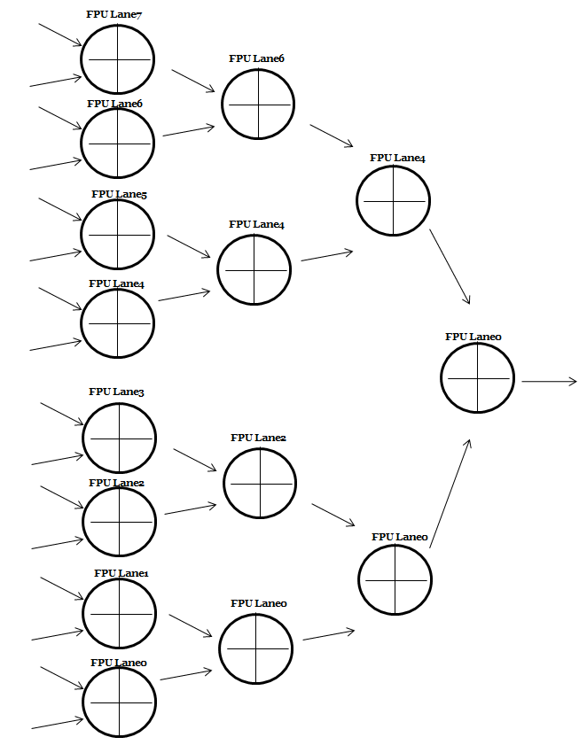
Reduction Sum Operation (Unordered)
Vs2[N]
Vs1[N]
.
.
.
D
TMP_result
Vs2[1]
Vs1[0]
12T
4T
4T
4T

Slide 28
Reduction Sum Operation (Unordered) for Lane
 | Result(T0) | Result(T1) | Result(T2) | Result(T3)
Lane0 | L0_T0 | L0_T0+L1_T0 | L0_T1+L2_T1 | L0_T2+L4_T2
Lane1 | L1_T0 | x | x
Lane2 | L2_T0 | L2_T0+L3_T0 | x
Lane3 | L3_T0 | x | x
Lane4 | L4_T0 | L4_T0+L5_T0 | L4_T1+L6_T1
Lane5 | L5_T0 | x | x
Lane6 | L6_T0 | L6_T0+L7_T0 | x
Lane7 | L7_T0 | x | x
LMUL>=1, T0= 12 cycles, T1, T2, T3 = 4 cycles

Slide 29
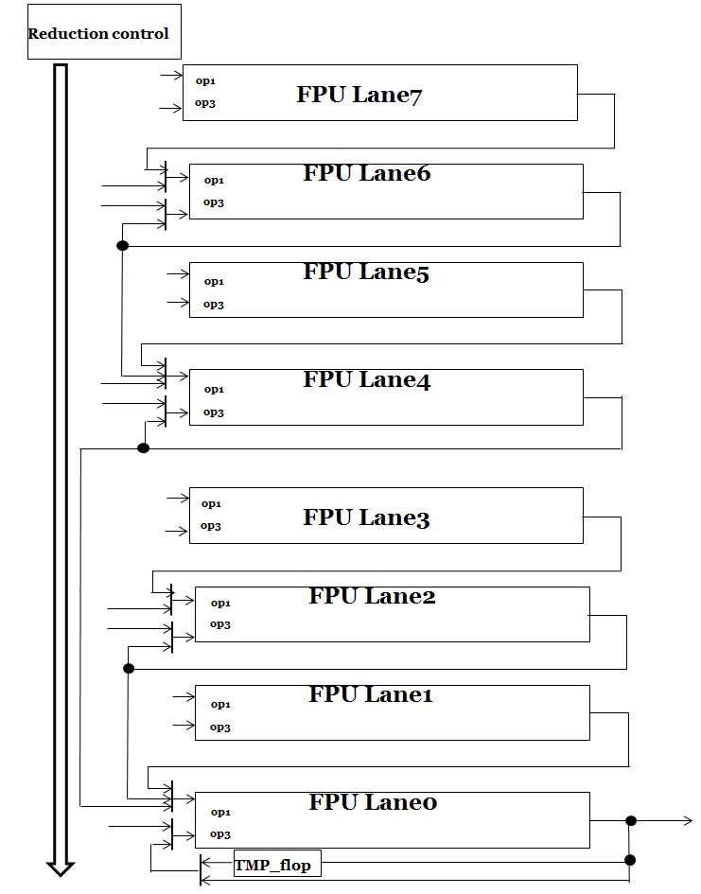
Reduction Sum Operation

Slide 30
Reduction Sum Operation

Slide 31
Reduction Sum Operation

Slide 32
Reduction Sum Operation

Slide 33
Reduction Sum Operation

Slide 34
Reduction Sum Operation (LMUL > 1)

Slide 35
Reduction Sum (Unordered) Instructions Latency
Instruction | Latency (sew=16)
Reduction sum (unordered) | ((Log2(elements)*4) + 4)*LMUL
Assume operation width is 512-bit, 8-lane (64-bit), maximum number of elements (16-bit) is 32 (512b/16b)
e.g. If LMUL is 1 and sew=16 then, latency is ((log2 (32))*4 + 4) * 1 = 24 cycles
Instruction | Latency (sew=32)
Reduction sum (unordered) | (Log2(elements)*4)*LMUL
Assume operation width is 512-bit, 8-lane (64-bit), maximum number of elements (32-bit) is 16 (512b/32b)
e.g. If LMUL is 1 and sew=32 then, latency is (log2 (16))*4) * 1 = 20 cycles

Slide 36
Reduction Sum Operation (Ordered)
Reuse the unordered logic for the reduction sum ordered operation.

Slide 37
Reduction Sum Operation (Ordered) per Lane0
 | T0 | T1 | T2 | T3 | T4 | T5 | T6 | T7 | T8 | T9 | T10 | T11 | T12 | T13 | T14 | T15 | T16
Pipe0 | Vs1[0] | Vs1[0] | Vs1[0] | Vs1[0] | Acc[0] | Acc[0] | Acc[0] | Acc[0] | Acc[1] | Acc[1] | Acc[1] | Acc[1] | Acc[2] | Acc[2] | Acc[2] | Acc[2] | Acc[3]
Pipe0 | Vs2[0] | Vs2[0] | Vs2[0] | Vs2[0] | Vs2[1] | Vs2[1] | Vs2[1] | Vs2[1] | Vs2[2] | Vs2[2] | Vs2[2] | Vs2[2] | Vs2[3] | Vs2[3] | Vs2[3] | Vs2[3]
Pipe1 | Vs2[1] | Vs2[1] | Vs2[1] | Vs2[1] | x | x | x | x | x | x | x | x | x | x | x | x
Pipe1 | 0 | 0 | 0 | 0 | x | x | x | x | x | x | x | x | x | x | x | x
Pipe2 | Vs2[2] | Vs2[2] | Vs2[2] | Vs2[2] | Vs2[2] | Vs2[2] | Vs2[2] | Vs2[2] | Vs2[3] | Vs2[3] | Vs2[3] | Vs2[3] | x | x | x | x
Pipe2 | 0 | 0 | 0 | 0 | 0 | 0 | 0 | 0 | 0 | 0 | 0 | 0 | x | x | x | x
Pipe3 | Vs2[3] | Vs2[3] | Vs2[3] | Vs2[3] | Vs2[3] | Vs2[3] | Vs2[3] | Vs2[3] | x | x | x | x | x | x | x | x
Pipe3 | 0 | 0 | 0 | 0 | 0 | 0 | 0 | 0 | x | x | x | x | x | x | x | x
Operation: vd[0] = sum( vs2[*] , vs1[0] ), T= 1 cycle

Slide 38
Reduction Sum Operation (Ordered)
 | T 16 | T 17 | T 18 | T 19 | T 20 | T 21 | T 22 | T 23 | T 24 | T 25 | T 26 | T 27 | T 28 | T 29 | T 30 | T 31 | T 32
Lane0 | Acc[3] | Acc[3] | Acc[3] | Acc[3] | Acc[4] | Acc[4] | Acc[4] | Acc[4] | Acc[5] | Acc[5] | Acc[5] | Acc[5] | Acc[6] | Acc[6] | Acc[6] | Acc[6] | Acc[7]
Lane0 | Vs2[4] | Vs2[4] | Vs2[4] | Vs2[4] | Vs2[5] | Vs2[5] | Vs2[5] | Vs2[5] | Vs2[6] | Vs2[6] | Vs2[6] | Vs2[6] | Vs2[7] | Vs2[7] | Vs2[7] | Vs2[7] | Vs2[8]
Lane1 | Vs2[5] | Vs2[5] | Vs2[5] | Vs2[5] | Vs2[6] | Vs2[6] | Vs2[6] | Vs2[6] | Vs2[7] | Vs2[7] | Vs2[7] | Vs2[7] | Vs2[8] | Vs2[8] | Vs2[8] | Vs2[8]
Lane1 | 0 | 0 | 0 | 0 | 0 | 0 | 0 | 0 | 0 | 0 | 0 | 0 | 0 | 0 | 0 | 0
…
Lane7

Slide 39
Reduction Sum Operation per Lane
Reduction control
Vs2[3]
FMAC pipeline3
op1
0
op3
Vs2[2]
FMAC pipeline2
op1
0
op3
Vs2[1]
FMAC pipeline1
op1
0
op3
Vs2[0]
FMAC pipeline0
Vs1[0]
op1
op3

Slide 40
Reduction Sum Operation per Lane
Reduction control
Vs2[3]
FMAC pipeline3
op1
Vs2[3]
0
op3
Vs2[2]
FMAC pipeline2
op1
0
op3
Vs2[2]
Vs2[1]
FMAC pipeline1
op1
0
op3
Vs2[1]
Vs2[0]
FMAC pipeline0
Vs1[0] + Vs2[0]
Vs1[0]
op1
op3

Slide 41
Reduction Sum Operation per Lane
Reduction control
Vs2[3]
FMAC pipeline3
op1
Vs2[3]
0
op3
Vs2[2]
FMAC pipeline2
op1
0
op3
Vs2[2]
Vs2[1]
FMAC pipeline1
op1
0
op3
Vs2[1]
Vs2[0]
FMAC pipeline0
Vs1[0] + Vs2[0] + Vs2[1]
Vs1[0]
op1
op3

Slide 42
Reduction Sum Operation per Lane
Reduction control
Vs2[3]
FMAC pipeline3
op1
Vs2[3]
0
op3
Vs2[3]
Vs2[2]
FMAC pipeline2
op1
0
op3
Vs2[3]
Vs2[1]
FMAC pipeline1
op1
0
op3
Vs2[1]
Vs2[1]
Vs2[0]
FMAC pipeline0
Vs1[0] + Vs2[0] + Vs2[1] + Vs2[2]
Vs1[0]
op1
op3

Slide 43
Reduction Sum Operation per Lane
Reduction control
Vs2[3]
FMAC pipeline3
op1
Vs2[3]
0
op3
Vs2[3]
Vs2[2]
FMAC pipeline2
op1
0
op3
Vs2[3]
Vs2[1]
FMAC pipeline1
op1
0
op3
Vs2[1]
Vs2[1]
Vs2[0]
FMAC pipeline0
Vs1[0] + Vs2[0] + Vs2[1] + Vs2[2]+Vs2[3]
Vs1[0]
op1
op3

Slide 44
Reduction Sum Operation

Slide 45
Reduction Sum (Ordered) Instructions Latency
Instruction | Latency (sew=16)
Reduction sum (ordered) | 4*32*LMUL(if LMUL=1, 128 cycles)
Assume operation width is 512-bit, 8-lane (64-bit), maximum number of elements (16-bit) is 32 (512b/16b)
Instruction | Latency (sew=32)
Reduction sum (ordered) | 4*16*LMUL(if LMUL=1, 64 cycles)
Assume operation width is 512-bit, 8-lane (64-bit), maximum number of elements (32-bit) is 16 (512b/32b)

Slide 46
Widening Operation
Convert the all source operand (e.g. 16-bit) to 32-bit (single precision) for the widening operation.
Case1: 2*SEW = SEW + SEW
Case2: 2*SEW = 2*SWE + SEW

Slide 47
Dot Product Operation
When EDIV is, the behavior of vector dot product operation is the same with the vector FMACC operation (latency is 4).
When EDIV is 2, the behavior of vector dot product operation is the similar to reduction unordered operation (latency is 12).

Slide 48
Dot Product Operation per Lane
Operation: Vd[i] = vd[i] + vs1[i] * vs2[i], ediv=1 and sew=16
Lane0 | Result(T0) | Result(T1)
pipe0 | Vs2[0]*Vs1[0] | P0_T0+Vd[0]
Pipe1 | Vs2[1]*Vs1[1] | P1_T0+Vd[1]
Pipe2 | Vs2[2]*Vs1[2] | P2_T0+Vd[2]
Pipe3 | Vs2[3]*Vs1[3] | P3_T0+Vd[3]
T= 4 cycles, the latency is 2T = 8

Slide 49
Dot Product Operation per Lane
Operation: Vd[i] = vd[31:0] + (vs1[31:16] * vs2[31:16]) +
(vs1[15: 0] * vs2[15: 0]), ediv=2 and sew=32
Lane0 | Result(T0) | Result(T1) | Result(T2)
pipe0 | Vs2[0][15:0]*Vs1[0][15:0] | P0_T0+P1_T0 | P0_T1+Vd[0]
Pipe1 | Vs2[0][31:16]*Vs1[0][31:16] | x | x
Pipe2 | Vs2[1][15:0]*Vs1[1][15:0] | P2_T0+P3_T0 | P2_T1+Vd[0]
Pipe3 | Vs2[1][31:16]*Vs1[1][31:16] | x | x
T= 4 cycles, the latency is 3T = 12

Slide 50
Dot Product Operation per Lane
Reduction control
Vs2[1][31:16]
FMAC pipeline3
op1
Vs1[1][31:16]
op2
Vs2[1][15:0]
FMAC pipeline2
op1
Vs1[1][15:0]
op2
Vs2[0][31:16]
FMAC pipeline1
op1
Vs1[0][31:16]
op2
Vs2[0][15:0]
FMAC pipeline0
Vs2[0][15:0]
op1
op2

Slide 51
Dot Product Operation per Lane
Reduction control
FMAC pipeline3
op1
Vs2[1][31:16] * Vs1[1][31:16]
op3
FMAC pipeline2
op1
Vs2[1][15:0] * Vs1[1][15:0]
op3
FMAC pipeline1
op1
Vs2[0][31:16] * Vs1[0][31:16]
op3
FMAC pipeline0
Vs2[0][15:0] * Vs1[0][15:0]
op1
op3

Slide 52
Dot Product Operation per Lane
Reduction control
FMAC pipeline3
op1
op3
Vd[1][31:0]
FMAC pipeline2
op1
(Vs2[1][31:16] * Vs1[1][31:16]) +
(Vs2[1][15:0] * Vs1[1][15:0])
op3
Vs2[1]
FMAC pipeline1
op1
0
op3
Vs2[1]
Vd[0][31:0]
FMAC pipeline0
(Vs2[0][31:16] * Vs1[0][31:16]) +
(Vs2[0][15:0] * Vs1[0][15:0])
op1
op3

Slide 53
Dot Product Operation per Lane
Reduction control
FMAC pipeline3
op1
op3
FMAC pipeline2
op1
(Vs2[1][31:16] * Vs1[1][31:16]) +
(Vs2[1][15:0] * Vs1[1][15:0])
+ Vd[1][31:0]
op3
FMAC pipeline1
op1
op3
FMAC pipeline0
(Vs2[0][31:16] * Vs1[0][31:16]) +
(Vs2[0][15:0] * Vs1[0][15:0])
+ Vd[0][31:0]
op1
op3

Slide 54
Instructions Latency
Instruction | Latency
ADD/SUB/MUL/MADD/MUSB | 4
DIV/SQRT | 17 (single precision) 10 (half precision)
DOT (ediv=1) | 8
DOT (ediv=2) | 12

Slide 55
Reduction Sum (Unordered) Instructions Latency
Instruction | Latency (sew=16)
Reduction sum (unordered) | ((Log2(elements)*4) + 4)*LMUL
Assume operation width is 512-bit, 8-lane (64-bit), maximum number of elements (16-bit) is 32 (512b/16b)
e.g. If LMUL is 1 and sew=16 then, latency is ((log2 (32))*4 + 4) * 1 = 24 cycles
Instruction | Latency (sew=32)
Reduction sum (unordered) | (Log2(elements)*4)*LMUL
Assume operation width is 512-bit, 8-lane (64-bit), maximum number of elements (32-bit) is 16 (512b/32b)
e.g. If LMUL is 1 and sew=32 then, latency is (log2 (16))*4) * 1 = 20 cycles

Slide 56
Reduction Sum (Ordered) Instructions Latency
Instruction | Latency (sew=16)
Reduction sum (ordered) | 4*32*LMUL(if LMUL=1, 128 cycles)
Assume operation width is 512-bit, 8-lane (64-bit), maximum number of elements (16-bit) is 32 (512b/16b)
Instruction | Latency (sew=32)
Reduction sum (ordered) | 4*16*LMUL(if LMUL=1, 64 cycles)
Assume operation width is 512-bit, 8-lane (64-bit), maximum number of elements (32-bit) is 16 (512b/32b)

